Slide 1
TUPLE ASSIGNMENT
An assignment to all of the elements in a tuple using a single assignment statement.
Python has a very powerful tuple assignment feature that allows a tuple of variables on the left of an assignment to be assigned values from a tuple on the right of the assignment.
The left side is a tuple of variables; the right side is a tuple of values.
Each value is assigned to its respective variable.
All the expressions on the right side are evaluated before any of the assignments. This feature makes tuple assignment quite versatile.
Naturally, the number of variables on the left and the number of values on the right have to be the same.

Slide 2


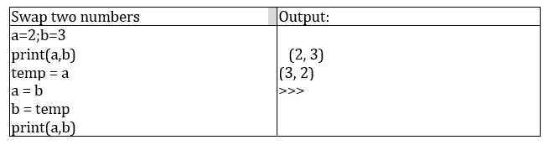
TUPLE ASSIGNMENT
Example:
It is useful to swap the values of two variables. With conventional assignment statements, we have to use a temporary variable. For example, to swap a and b:

Slide 3
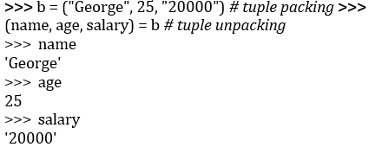
TUPLE ASSIGNMENT
Tuple assignment solves this problem neatly:
(a, b) = (b, a)
One way to think of tuple assignment is as tuple packing/unpacking.
In tuple packing, the values on the left are ‘packed’ together in a tuple:
>>> b = ("George", 25, "20000") # tuple
In tuple unpacking, the values in a tuple on the right are ‘unpacked’ into the variables/names on the right:

Slide 4
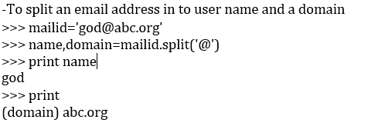
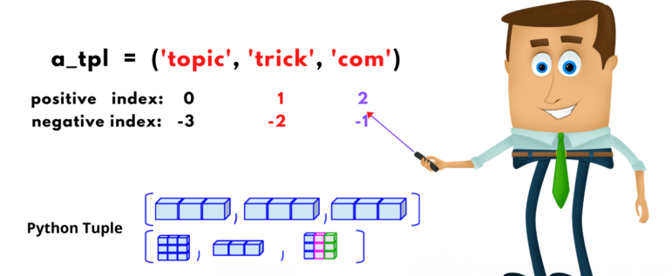
TUPLE ASSIGNMENT
The right side can be any kind of sequence (string,list,tuple)

Slide 5
OPERATORS
Operators are the constructs which can manipulate the value of operands.
Consider the expression 4 + 5 = 9. Here, 4 and 5 are called operands and + is called operator
Types of Operators:
-Python language supports the following types of operators
Arithmetic Operators
Comparison (Relational) Operators
Assignment Operators
Logical Operators
Bitwise Operators
Membership Operators
Identity Operators

Slide 6
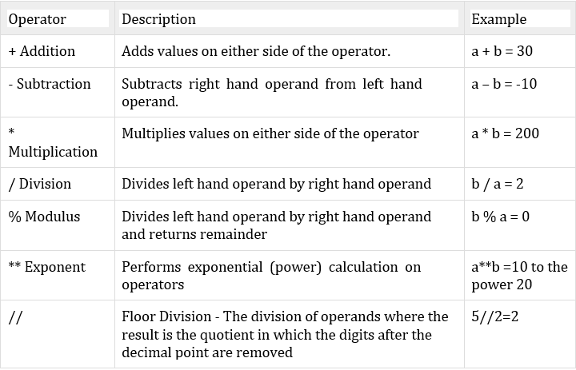
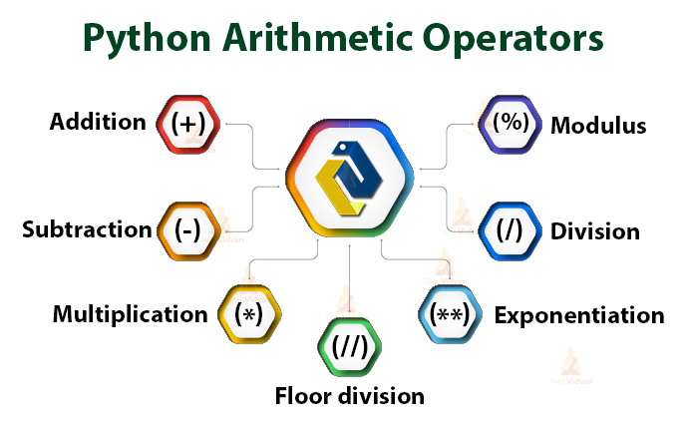
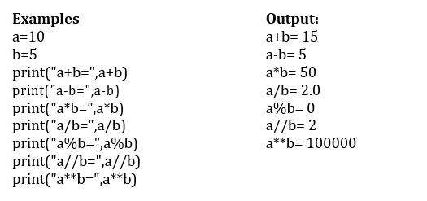
Arithmetic operators
They are used to perform mathematical operations like addition, subtraction, multiplication etc. Assume, a=10 and b=5

Slide 7

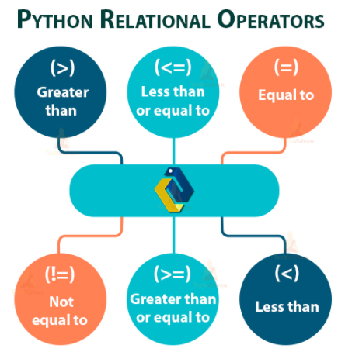
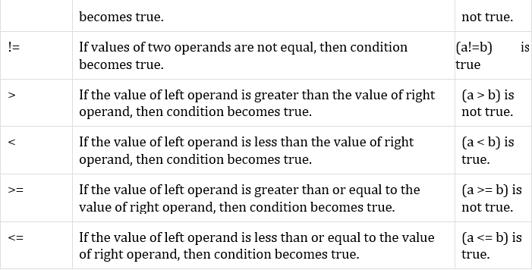
Comparison (Relational) Operators:
Comparison operators are used to compare values.
It either returns True or False according to the condition. Assume, a=10 and b=5

Slide 8
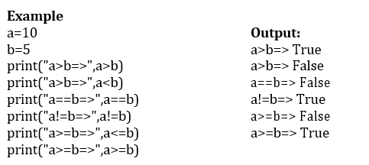
Comparison (Relational) Operators:
Comparison operators are used to compare values.
It either returns True or False according to the condition. Assume, a=10 and b=5

Slide 9
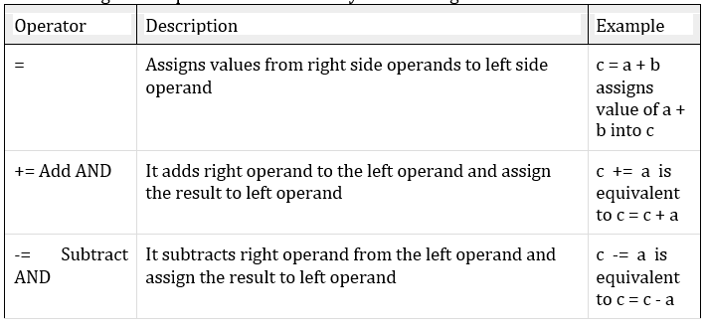
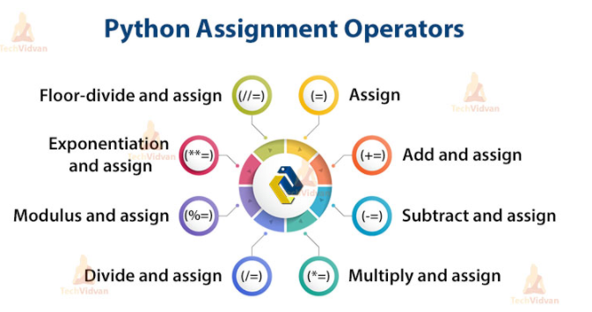
Assignment Operators
Assignment operators are used in Python to assign values to variables.

Slide 10
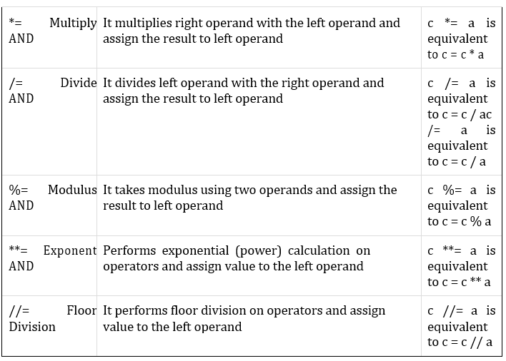
Assignment Operators

Slide 11
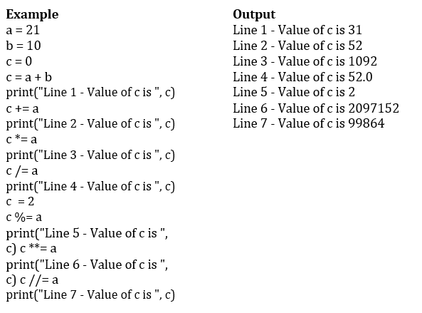
Assignment Operators

Slide 12
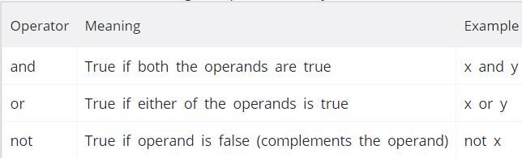
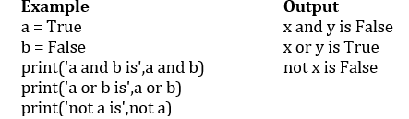
Logical Operators
Logical operators are the and, or, not operators.

Slide 13
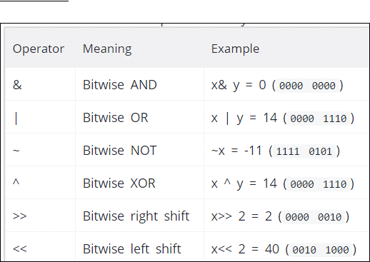
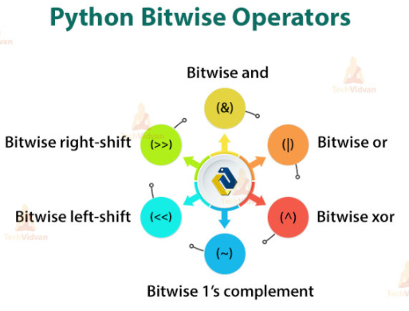
Bitwise Operators:
A bitwise operation operates on one or more bit patterns at the level of individual bits
Example: Let x = 10 (0000 1010 in binary) and y = 4 (0000 0100 in binary)

Slide 14
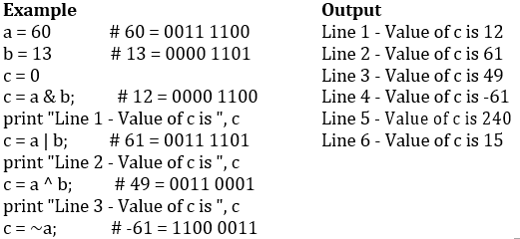
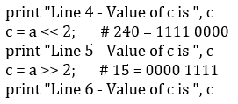
Bitwise Operators:
A bitwise operation operates on one or more bit patterns at the level of individual bits

Slide 15
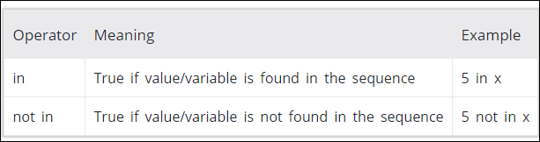
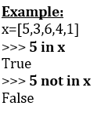
Membership Operators
Evaluates to find a value or a variable is in the specified sequence of string, list, tuple, dictionary or not.
Let, x=[5,3,6,4,1]. To check particular item in list or not, in and not in operators are used.

Slide 16
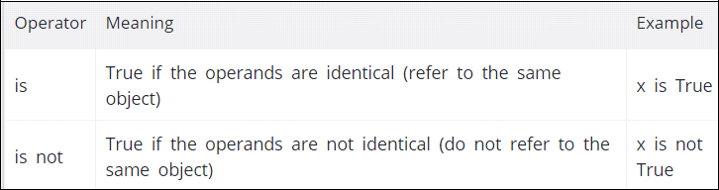
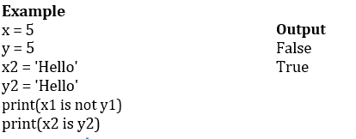
Identity Operators
They are used to check if two values (or variables) are located on the same part of the memory

Slide 17
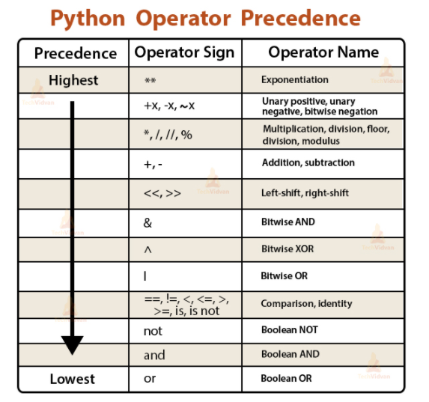

Slide 18
OPERATOR PRECEDENCE
When an expression contains more than one operator, the order of evaluation depends on the order of operations.

Slide 19
OPERATOR PRECEDENCE
For mathematical operators, Python follows mathematical convention.
The acronym PEMDAS (Parentheses, Exponentiation, Multiplication, Division, Addition, Subtraction) is a useful way to remember the rules:
Parentheses have the highest precedence and can be used to force an expression to evaluate in the order you want. Since expressions in parentheses are evaluated first, 2 * (3-1)is 4, and (1+1)**(5-2) is 8.
You can also use parentheses to make an expression easier to read, as in (minute*100) / 60, even if it doesn’t change the result.

Slide 20
OPERATOR PRECEDENCE
Exponentiation has the next highest precedence, so 1 + 2**3 is 9, not 27, and 2 *3**2 is 18, not 36.
Multiplication and Division have higher precedence than Addition and Subtraction. So 2*3-1 is 5, not 4, and 6+4/2 is 8, not 5.
Operators with the same precedence are evaluated from left to right (except exponentiation).

Slide 21
Example:

Slide 22
a = 20
b = 10
c = 15
d = 5
e = 0
e = (a + b) * c / d #( 30 * 15 ) / 5
print "Value of (a + b) * c / d is ", e
e = ((a + b) * c) / d # (30 * 15 ) / 5
print "Value of ((a + b) * c) / d is ", e
e = (a + b) * (c / d); # (30) * (15/5)
print "Value of (a + b) * (c / d) is ", e

Slide 23
e = a + (b * c) / d; # 20 + (150/5)
print "Value of a + (b * c) / d is ", e
Output is:
Value of (a + b) * c / d is 90
Value of ((a + b) * c) / d is 90
Value of (a + b) * (c / d) is 90
Value of a + (b * c) / d is 50

